Slide 1
Product Demonstration and Testing Results
Team Members: Zijian Song, Levi McAdams, Samuel Torres, Eric Hinds, Tyler Allen

Slide 2
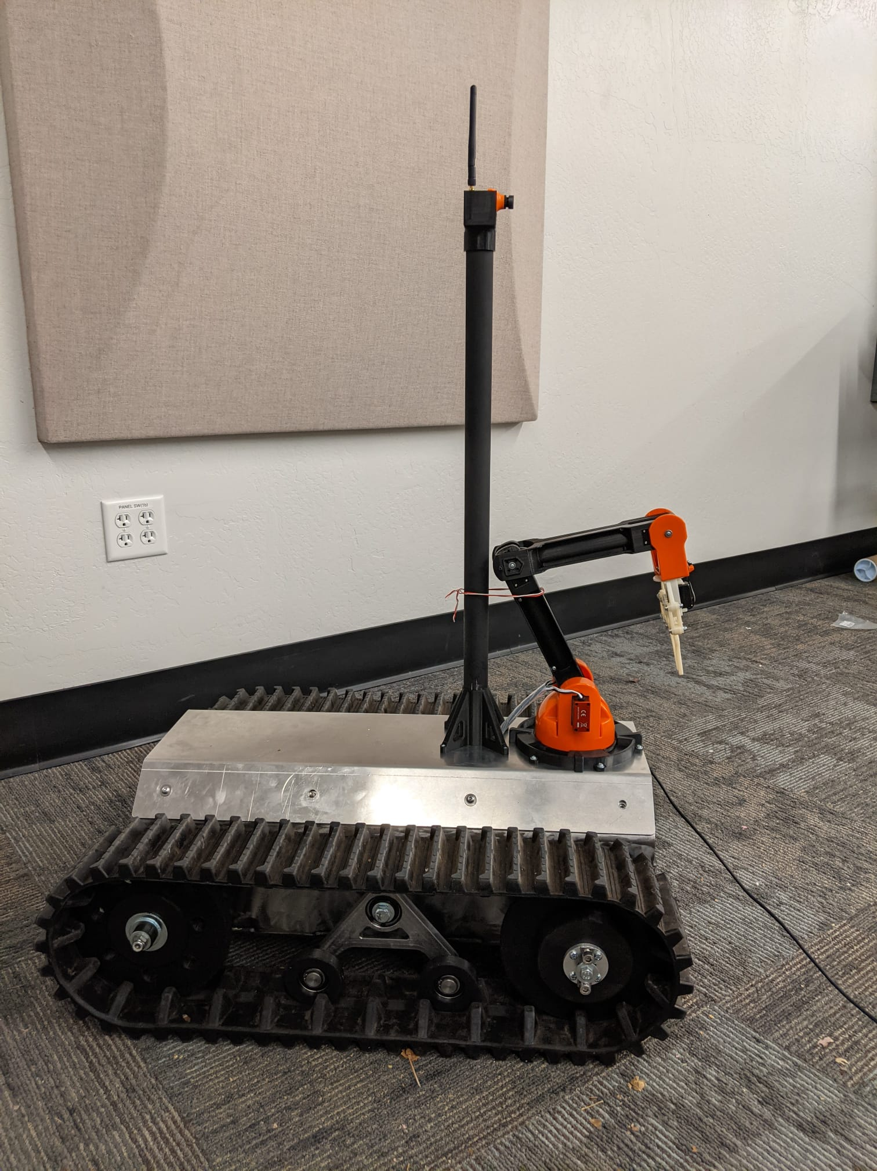
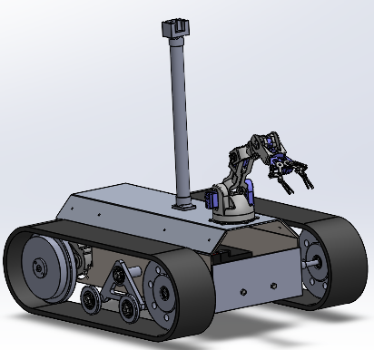
From CAD to Reality!
Figure 1: CAD Design
Figure 2: Robot on Mars
Samuel T.

Slide 3
Design Requirements
 | Customer Requirements
CR1 | Increase Maneuverability
CR2 | Accurate VR Control
CR3 | Easy to Use
CR4 | Large Work Space
CR5 | Rigid Design
CR6 | Durable
CR7 | Fast Controls
CR8 | Cost Effective
CR9 | Powerful
CR10 | Multidirectional Control
 | Engineering Requirements | Target Values
ER1 | Decrease Turn Radius | 2 meters
ER2 | Low Visual Latency | 0.3 seconds (subjective)
ER3 | Large Work Space | 0.5 meters
ER4 | Decrease Turn TIme | 35 degrees/second
ER5 | Reasonable Factor of Safety | 2
ER6 | Program Speed | 400 ms
ER7 | Minimum Payload | 0.05 kg
Table 2: Engineering Requirements
Table 1: Customer Requirements
Tyler Allen

Slide 4
Top Level Testing Summary
Experiment/Test | CR/ER
Experiment 1: Turn Time | CR1, CR7, CR3, CR9, ER4
Experiment 2: Turn Radius | CR1, CR3, CR9, ER1
Experiment 3: Obstacle Course | CR1, CR3, CR6, CR9
Experiment 4: Lift Test | CR3, CR2, CR10, ER7
Experiment 5: Latency Test (Camera) | CR2, CR3, ER2
Experiment 6: FEA Test | CR5, CR9, ER5
Experiment 7: Program Response Time | CR2, CR3, ER6
Experiment 8: System Trials | All ER’s/CR’s Apply Via Simulated Use
Table 3: Top Level Testing Summary
Tyler Allen

Slide 5
Testing Plan
Experiment 1
Variable Investigated: degrees/second
Procedure: Record full 360 degree turn and divide by the time taken
Results Expected: Well above ER of 35 degrees/second
Results: 73.78 degrees/second
Experiment 2
Variable Investigated: Turn Radius in meters Procedure: Measure and mark turn radius
Results Expected: < 2 meters
Results: 0.81 meters
Experiment 3
Concept Investigated: Mobility
Procedure: Test RUT on different surfaces and over various obstacles
Results Expected: Can climb up stairs
Results: Can climb up stairs up to 0.35m(only with drive wheels forward)
Experiment 4
Variable Investigated: Payload in kilograms Procedure: Test arm lift capacity using objects of a known weight
Results Expected: Max Payload of 0.25 kg
Results: Max Payload of 0.23kg
Levi M.

Slide 6
Testing Plan
Experiment 5
Concept Investigated: Visual Latency
Procedure: Each person controls RUT through the headset to see if a delay is noticed
Results Expected: Small delay seen
Results: Little to no delay can be seen
Est. < 50 ms
Experiment 6
Variable Investigated: Factor of safety Procedure: FEA via SolidWorks
Results Expected: > 2
Results: Minimum factor of safety of 2.37
Experiment 7
Variable Investigated: Response time (milliseconds)
Procedure: Record time for the program to refresh after an input
Results Expected: < 400 ms
Results: 500 ms
Experiment 8
Concept Investigated: Is the device usable? Procedure: Try out everything and perform a task
Results Expected: Pick up and transport an object from one side of the room to the other.
Results: Success
Eric Hinds

Slide 7
Specifications
Customer Requirements
Table 4: Customer Requirements Specs
Customer Requirement | Is Requirement Met | Client Accepted
CR1 - Increase Maneuverability | Yes
CR2 - Accurate VR control | Yes
CR3 - Easy to use | Yes
CR4 - Large work space | Yes
CR5 - Ridgid design | Yes
CR6 - Durable | Yes
CR7 - Fast controls | Yes
CR8 - Cost effective | Yes
CR9 - Powerful | Yes
CR10 - Multi Directional force | Yes
Samuel T.

Slide 8
Testing Results
Table 5: Engineering Requirements Specs
Engineering Requirement | Target | Tolerance | Measured Value | Requirement Met | Client Accepts
ER1 Decreased Turn Radius | 2 m | + .25 m | 0.81 m | Yes
ER2 - Low Visual Latency | 0.3s | + 0.2s | <50 ms | Yes
ER3 - Work Space Size | 0.5 m | - 0.1 m | 0.81 m | Yes
ER4 Decreased Turn Time | 35 degrees/s | - 5 degrees/s | 72.78 +/- 4 degrees/s | Yes
ER5 Reasonable Factor of Safety | 2 | - 0 | 2.37 | Yes
ER6 Program Speed | 400 ms | + 300 ms | 500 ms | Yes
ER7 Minimum Payload | 0.25 kg | - 0.05 kg | 0.23 kg | Yes
Samuel T.

Slide 9
Final Budget
Our team was successful in staying within budget the entire project, by well over $1000, which allowed our group to not worry about future expenses.
Table 6: Budget.
Current Budget | Expenses To Date | Future Expenses | Extra
$2,500 | $1,368 | $0 | $1,132
Eric H.

Slide 10
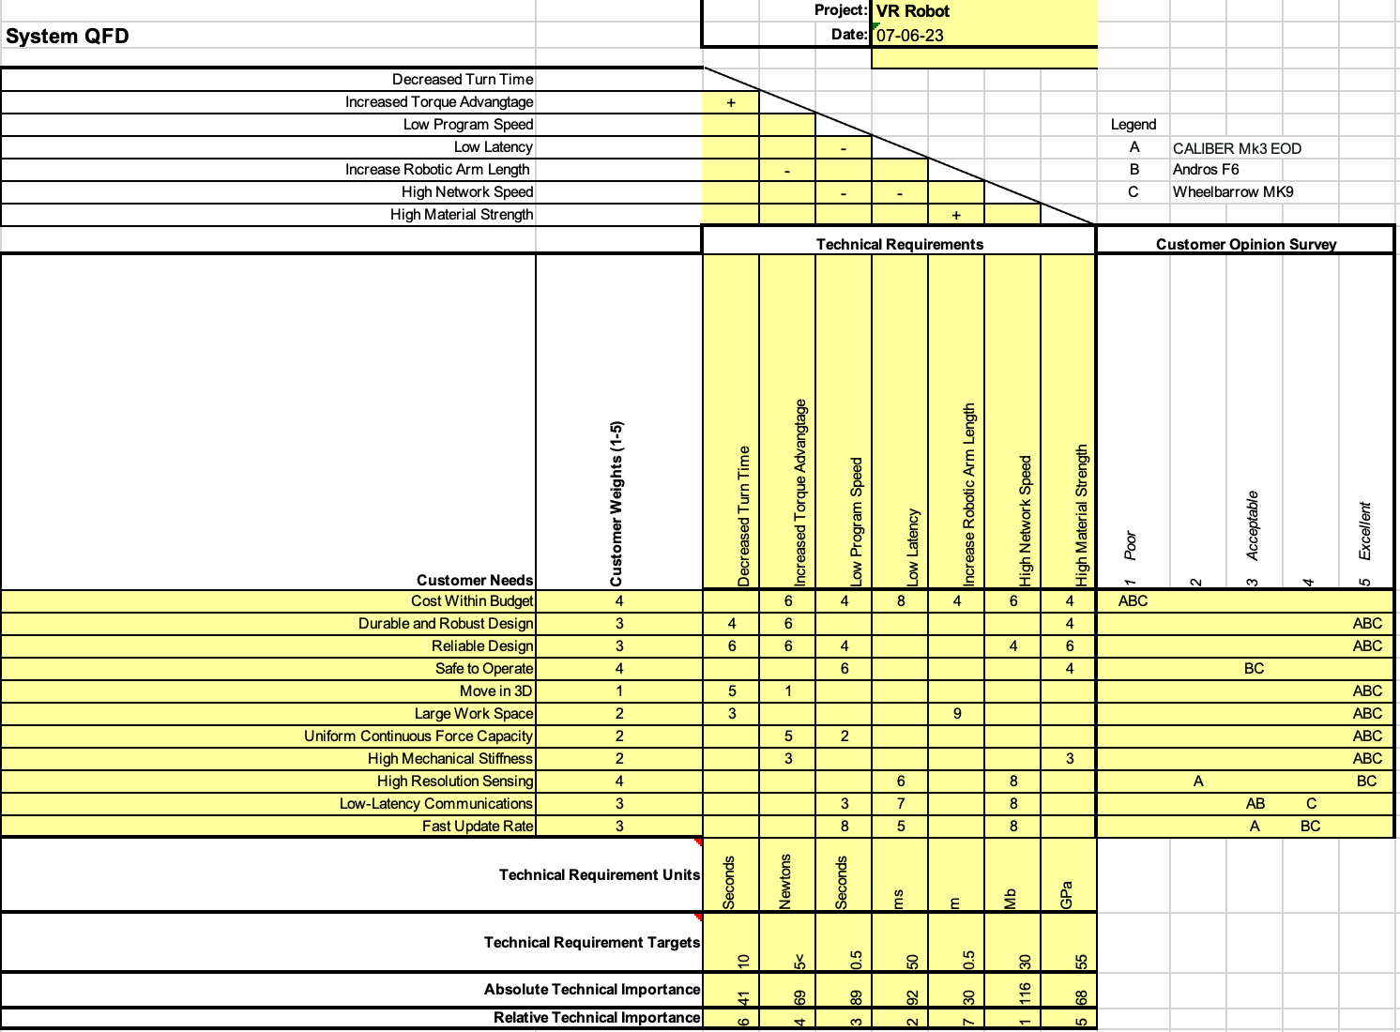
QFD
Table 7: QFD
Tyler Allen

Slide 11
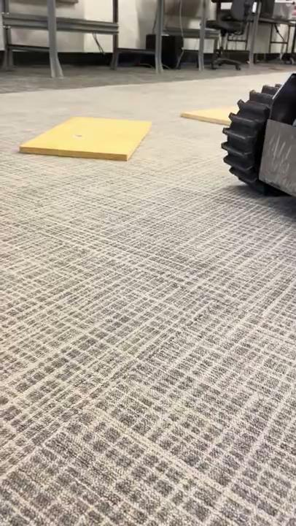
Demonstration
Video 1: Small Obstacle
Levi McAdams

Slide 12

Demonstration
Video 2: RUT Turning
Video 3: Climbing Steps
Levi McAdams

Slide 13
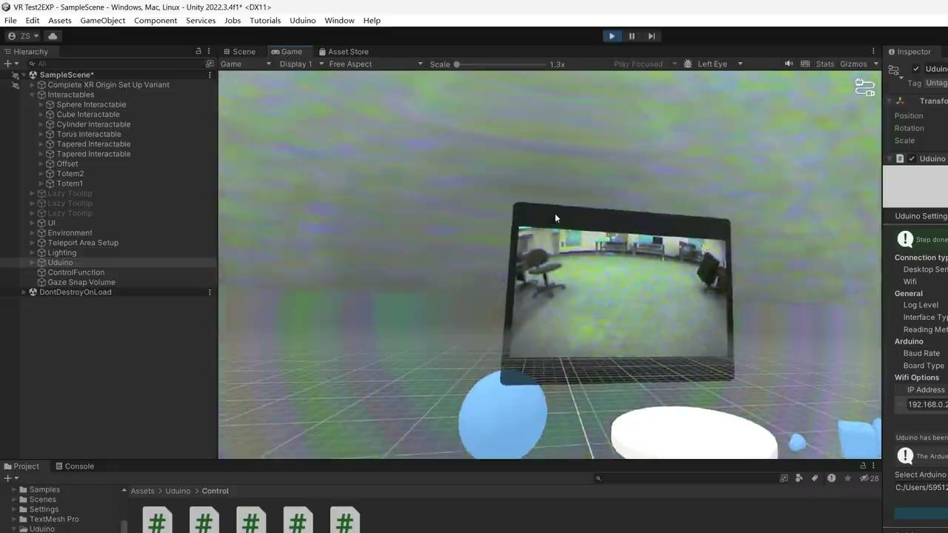
Demonstration
Video 4: VR Program
Video 5: System Testing
Zijian Song

Slide 14
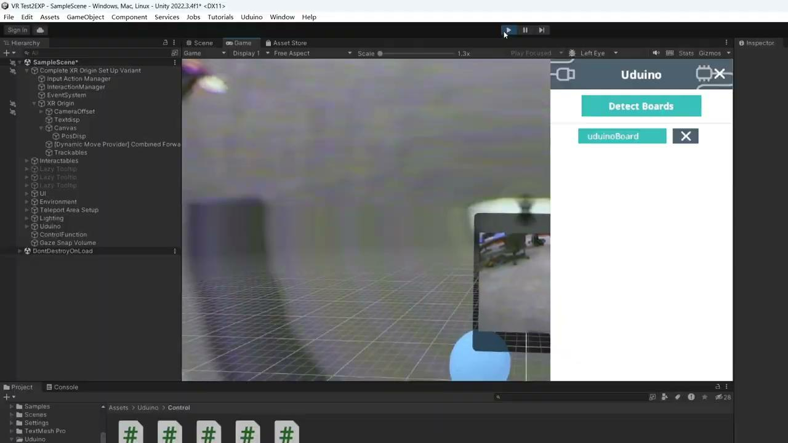
Demonstration
Video 6: Full VR Control
Video 7: VR View
Zijian Song

Slide 15
Thank You
14

Slide 16
Questions?
16

